Slide 1
The queens of the last 3 years

Slide 2
What do they have in common?
The purpose of this research is to find out if any of the current female singers/artists have managed to enter the top 5 most listened to womenduring the last two years, 2016-2017-2018. Knowing this way if there is awoman who has succeeded. And, if she has, what style of music has she done to maintain this status?

Slide 3
Triumph being a woman
A secondary objective of this study would be to know if there is anything in common between those 15 songs that would form the top 5 of the last 3 years to know what would be the formula to "triumph being a woman".

Slide 4
Let's talk about evolution.

Slide 5
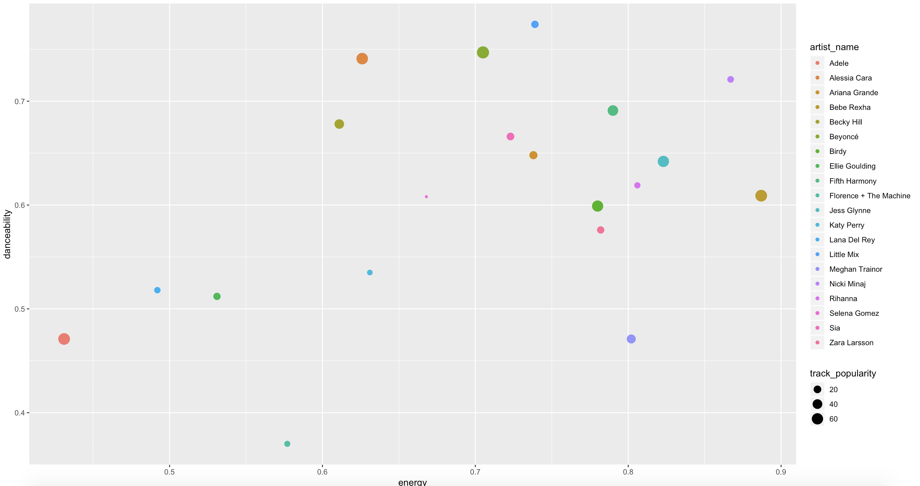
Statistics in 2016
When talking about the statistics in 2016, we can see that the top 5 songs of 2016 in ascending order were: Starting at the end we have Jess Glynne with “Hold my hand", then we have Alessia Cara with "Wild things", the next is Adele with "Hello", ahead we have Bebe Rexha with "I got You", and as 2016 champion we have Beyoncé with 7/11.

Slide 6
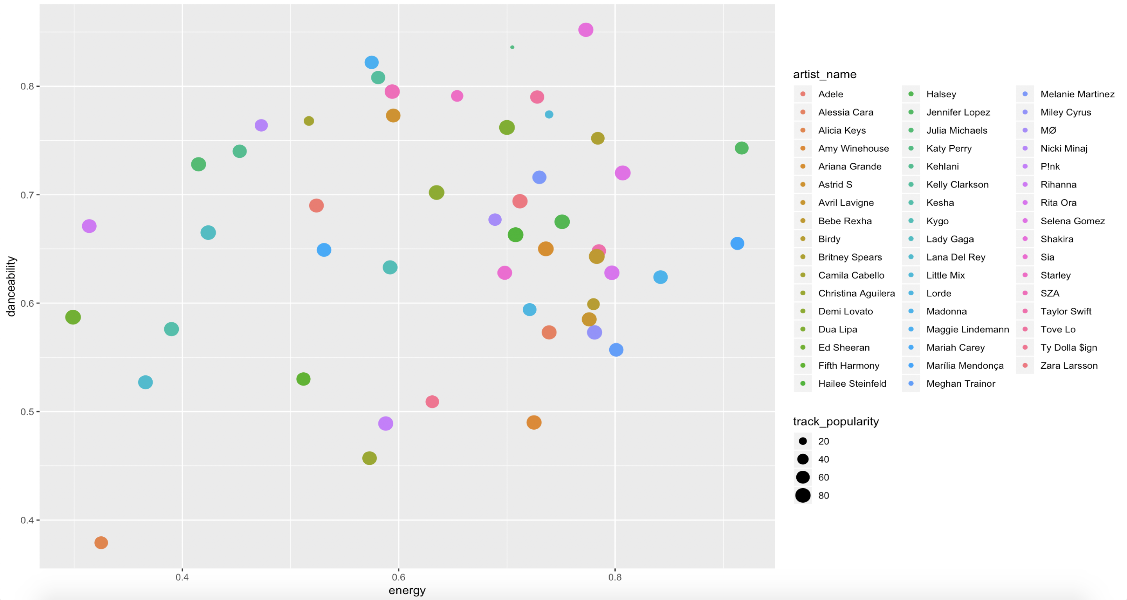
Statistics in 2017
We speak again in ascending order of most listened, beginning with the number 5, we find Ariana Grande with "Side to Side", a step above we have Hailee Steinfeld with "Let me go", the top 3 is opened by Bebe Rexha with "Meant to Be", the runner-up is Dua Lipa with "New Rules" and the list is headed by Selena Gomez with "Wolves".

Slide 7
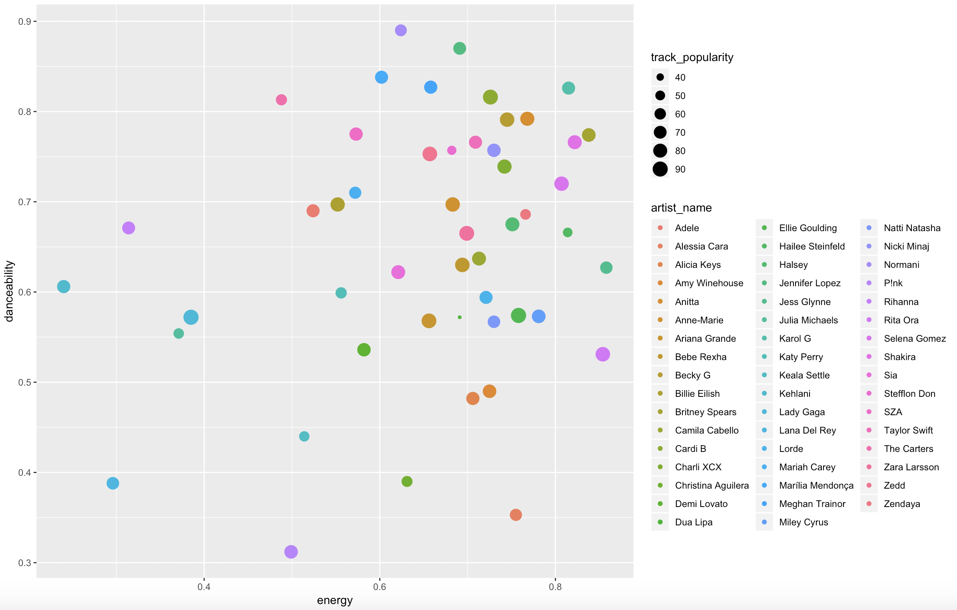
Statics in 2018
And we finish with the year 2018, "Breathing" is the song that opens the top 5 sung by Ariana Grande, then we find "Ruin My Life" by Zara Larsson, the one that opens this time the top 3 is a rapper called Cardi B with "I like it", the princess of this year would be Ellie Goulding with "Close to Me" and The Crown takes Lady Gaga with the song "Shallow" that sings in the movie: A star has born.

Slide 8
First conclusions
What may attract the most attention throughout the research is the fact that there has been an increase in the number of female artists in the last 3 years and what is recognized as a great advance.
Another of the deductions we can make is that although in the top 5 there is always some well known singer, many of the singers who enter this top 5 are "new stars" such as Dua Lipa, Alessia Cara, Bebe Rexha the first year .
And another point we can deduce for the moment is that most of the most famous songs have a fairly high level of danceability and energy.

